Slide 1
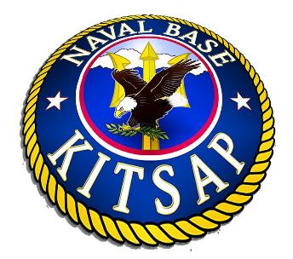
Serving The Fleet, Fighter & Family
NAVAL BASE KITSAP
Notes:
Hello,
My name is _______________, and I’m the _______________ for Naval Base Kitsap, also known as “NBK”.
Please allow me to briefly go over what we do, the impact we have on businesses in the Puget Sound area, and how your support is important.

Slide 2
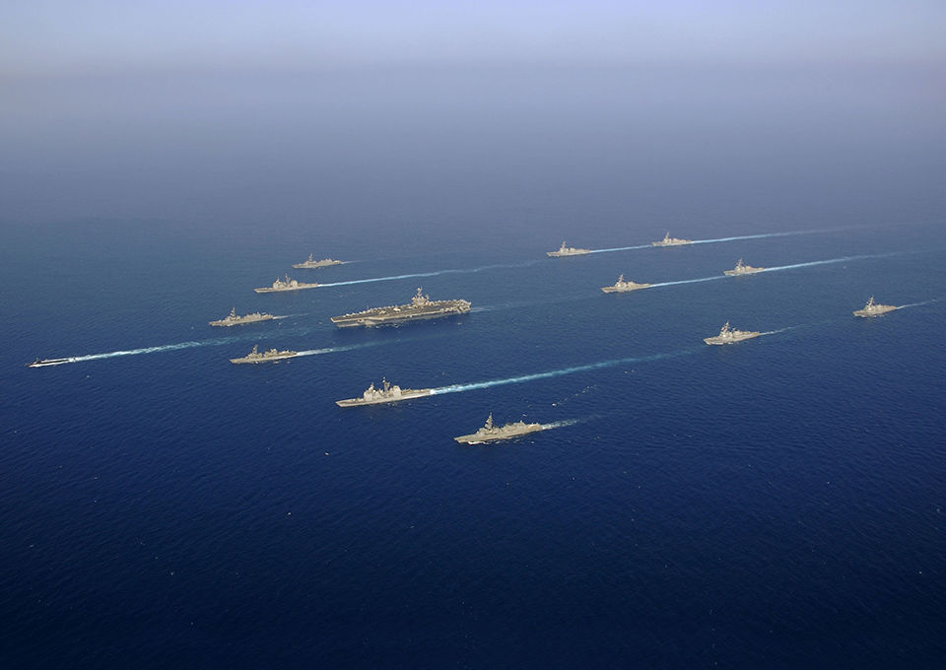
U.S. NAVY MISSION
“The Navy maintains, trains and equips combat-ready military forces capable of winning wars, deterring aggression, and maintaining freedom of the seas.”
-Adm. John Richardson, Chief of Naval Operations
Notes:
Why do we have a Navy?
It’s a Constitutional Mandate: Article 1, Section 8
The mission of the Navy is to maintain, train and equip combat-ready Naval forces capable of winning wars, deterring aggression and maintaining freedom of the seas.
NOTE: Felt it was necessary to break the eight-word count, due to the power of having a visual quote from the Navy CNO.

Slide 3
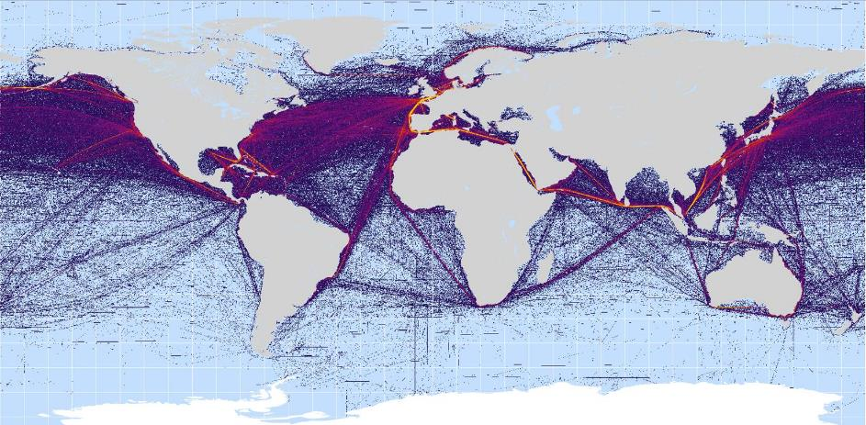
MARITIME ROUTES & CROSSROADS
Notes:
Our world relies heavily on oceans. The United States is a maritime nation.
We trade heavily by ships/vessels, which means maintaining our sea lanes for commerce is a strategic priority.
Our founding fathers recognized this, and created the Navy by writing it into the U.S. Constitution.
I also like to point out that:
70% of the earth is covered in water,
80% of the planet’s population lives within close proximity to coastal areas, and
90% of global commerce is conducted by sea.

Slide 4
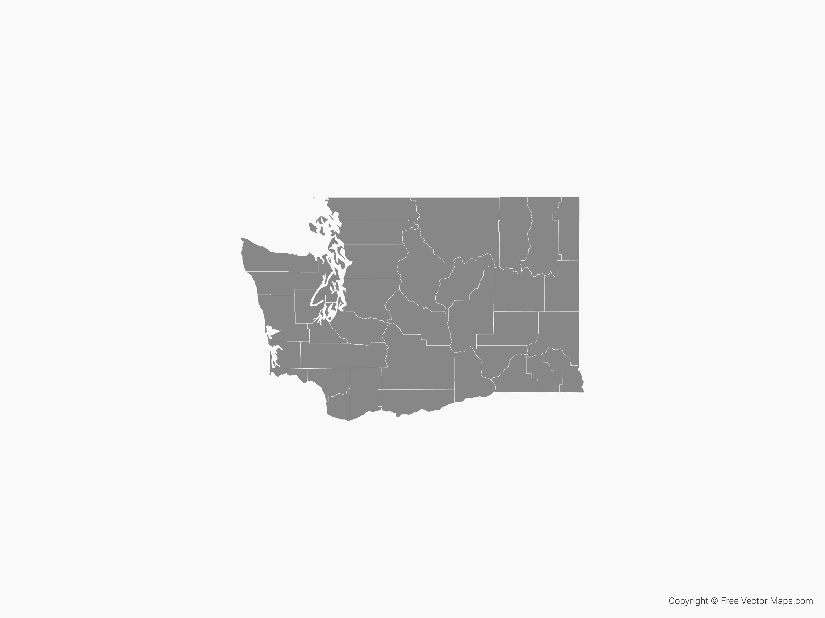
FIVE INSTALLATIONS
BANGOR
BREMERTON
JACKSON PARK
KEYPORT
MANCHESTER
Notes:
In June 2004, Naval Base Kitsap was consolidated from five major local bases on the Kitsap Peninsula into one cost-cutting measure.
The bases Include (click anywhere before announcing each):
Bangor,
Bremerton,
Jackson Park,
Keyport, and
Manchester
In short, I do a lot of driving!

Slide 5
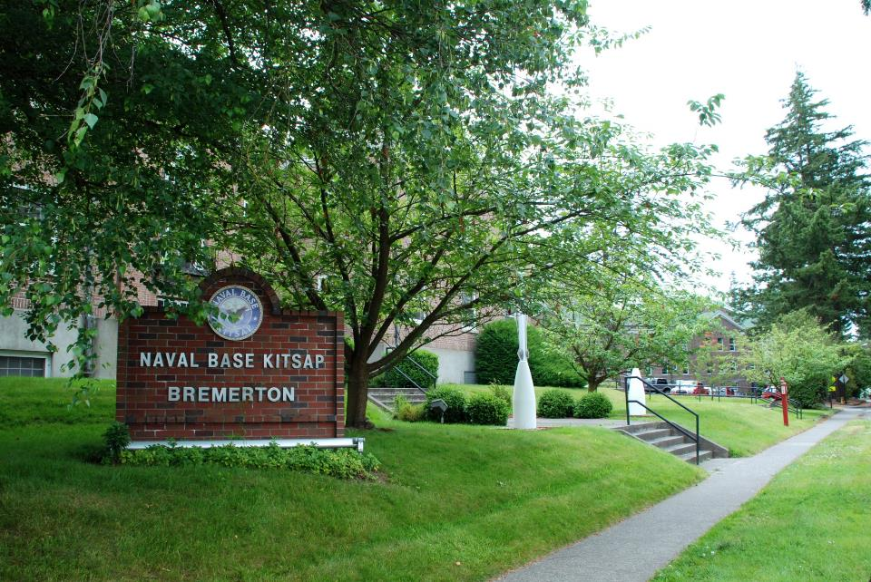
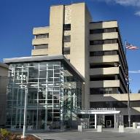
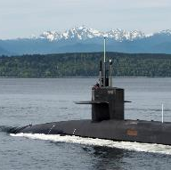
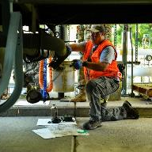
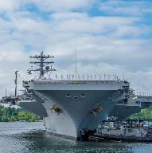
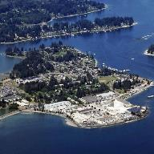
FIVE INSTALLATIONS
Notes:
We have nearly 70 (64 to be exact) tenant commands located on NBK. I’ll mention some of our major ones.
(Again, click anywhere before discussing each installation)
NBK Bangor, located just past Silverdale, we have four major commands: Submarine Group 9 (with three submarine squadrons and Trident Training Facility), Naval Facilities and Engineering Command Northwest (NAVFAC NW), Navy Region Northwest (NRNW), and Strategic Weapons Facility Pacific (SWFPAC).
NBK Bremerton is where our command is headquartered. It’s also where you can find Puget Sound Naval Shipyard and Intermediate Maintenance Facility (PSNS & IMF), two Nimitz-class aircraft carriers USS Nimitz (CVN 68), USS John C. Stennis (CVN 74), two Seawolf type attack submarines, Naval Supply and Logistics Center Fleet Logistics Center (NAVSUP FLC) Puget Sound, and two-four decommissioning submarines.
NBK Jackson Park is the home of Naval Hospital Bremerton (NHB), and it also has one of our largest housing communities, with 615 houses.
The major tenant at NBK Keyport is Naval Undersea Warfare Center (NUWC) Division Keyport.
NBK Manchester is Manchester Naval Fuel Depot.
We also have other Washington Parcels: Camp McKean, Camp Wesley Harris, and Dabob Bay where we perform a lot of our training.

Slide 6
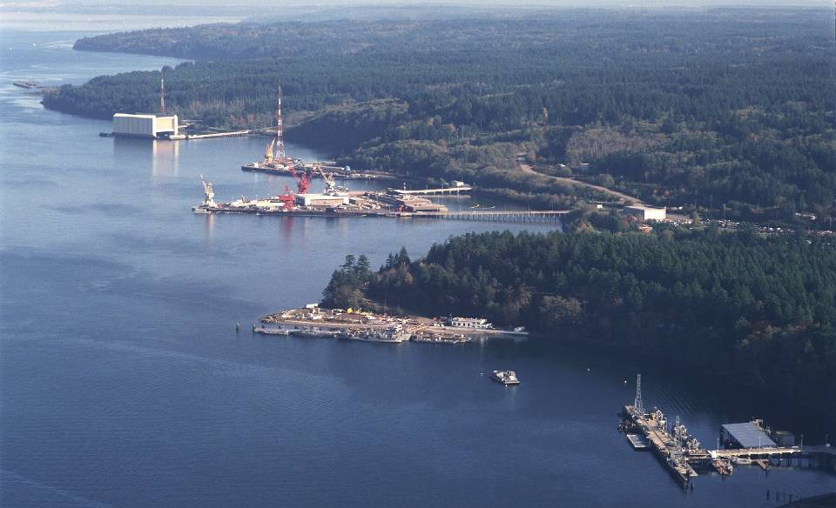
LANDSCAPE
$10.6 BILLION
12,348 ACRES
35,000 WORKERS
1,811 FACILITIES
Notes:
This is an overview of our landscape:
The Navy is working on funding for new study, includes two carriers, and thousands more workers mainly at PSNS & IMF. The Navy and your businesses feel that impact.
These figures show current value of our value land, buildings, and piers. They Don’t include ships, submarines, weapons.
(click) Our Plant Replacement Value is $10.6 billion. We cover 12,438 total acres.
(click) NBK and the tenants employ about 35,000 workers on a daily basis. This includes 16,200 military personnel, 17,600 Department of Defense civilians, and 7,500 contractors. The base also supports about 25,000 retirees in the area.
The most recent study of economic impact shows our annual payroll at more than $2 billion.

Slide 7
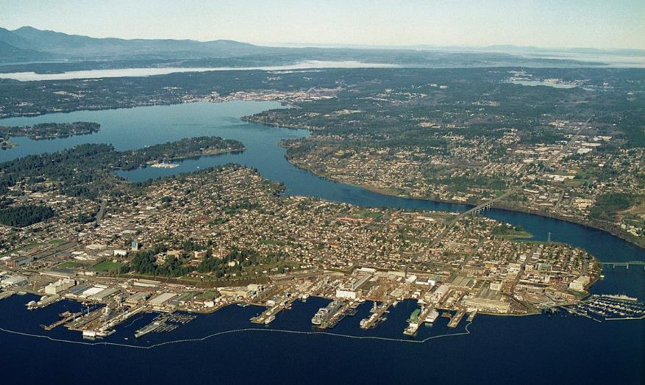
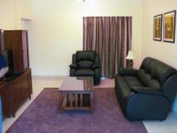
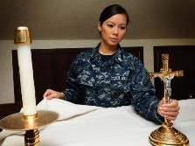
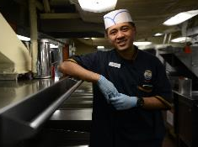
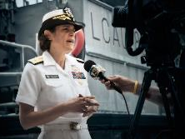
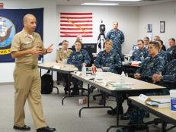
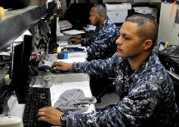
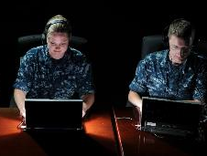
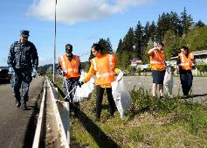

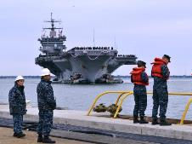
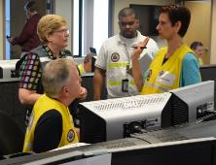

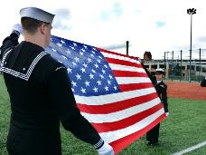
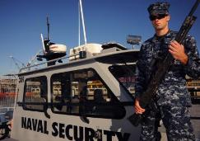
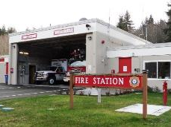
FLEET, FIGHTER & FAMILY
HOW WE PROVIDE SUPPORT …
Notes:
What goes on behind the fence? NBK is like a little city. We keep the lights on, water running, and poop going to the right places.
NBK’s mission is to support the Fleet, Fighter, and Family.
Even more simply put, our job is to help get ships to sea, because a Navy that doesn't send ships to sea, is really an Army.
Ships and submarines rely on the shore infrastructure at home taking care of the families.
Behind the fence we have hotels, restaurants, bowling alleys, fire and police services and churches. Allow me to go over some of them.
(click before each)
-Chapel/Religious Services provide spiritual support as well as life and relationships improvement courses.
-Public Affairs - Media relations and community outreach
-Administration - Full range of administrative support
-1st Lieutenant - Base zone inspections & clean-ups
-Port Operations - Services to vessels including infrastructure coordination and vessel movements
-Security - Force protection as well as on base law enforcement
-Harbor Security - Patrols and secures NBK waterfront
-Fire and Emergency Services - Base services as well as mutual aid
-Funerals and Honor Guard - In 2016, completed 271 funeral and color guard requests
-Emergency Management - Emergency response and preparedness coordination - StormReady Installation
-Public Works - Base operating support services, utilities and environment management
-Information Technology -Safe, secure and reliable required communication, data, and information services
-Training - Coordinates base-wide drills and ensures personnel receive proper training
-Dining facility - Serves 1,400 meals a day to NBK and tenant command service members
-Unaccompanied Housing - Housing for over 4,000 service members
We really are a small city.

Slide 8
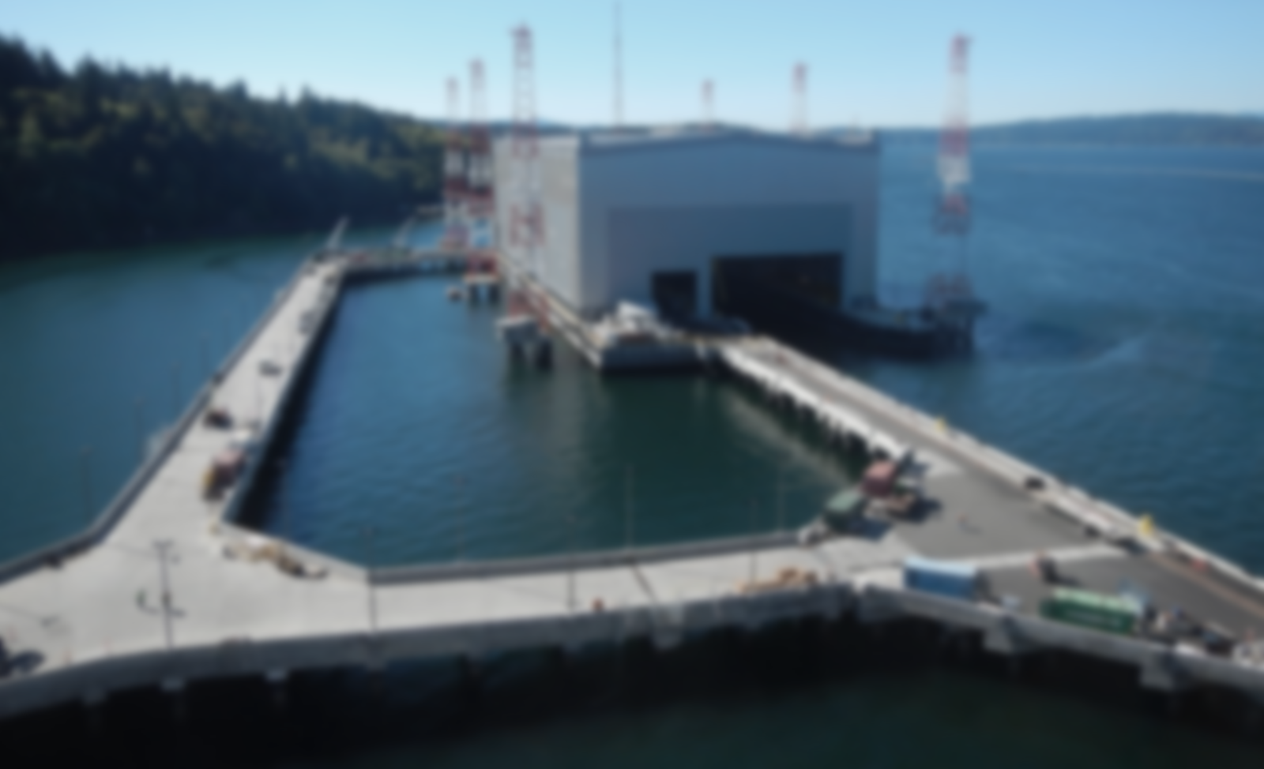
YESTERDAY, TODAY & TOMMORROW
2004
2018
Notes:
So what does the Navy think of Kitsap?
We have grown a lot since 2004
(click, then click on “2004”)
In 2004, we had one carrier, six Trident submarines, two other attack subs, USMC Security Company (400 personnel), two Research & Development operations at Bangor: Submarine Development Squadron 5 and NUWC
(click, then click on “2018”)
Now, we have two carriers, eight Tridents, two Ohio-class subs, three Seawolf-class subs, decommissioning subs cycling with average of 3-4, three R&D operations: COMSUBDEVRON 5 (mission increasing), NUWC (mission increasing, torpedo depot , Naval Surface Warfare Center, Carderock Division, Strategic Weapons Facility – Pacific, USMC Security Force Battalion (1,100 personnel), Transit Protection Service (sub escort) mission: Bangor, 16 operational craft, 145 USCG personnel, Coastal Riverine Squadron- High Value Unit (HVU) Detachment, six 36-ft. patrol boats, 70 Active and 52 Reservists, and two Explosive Handling Wharfs.
Housing data also confirms we’ve grown.
If you look at an overhead view of NBK in 2004 and one today, you will see a few things. In Bremerton, we have one less, very small pier in Bremerton and one new barracks building. In Bangor, we have a second Explosive Handling Wharf, or barn, on the Hood Canal. Basically, one new building, parking garages, and only a few new houses.
For the most part, we have what we did under the old force structure.

Slide 9
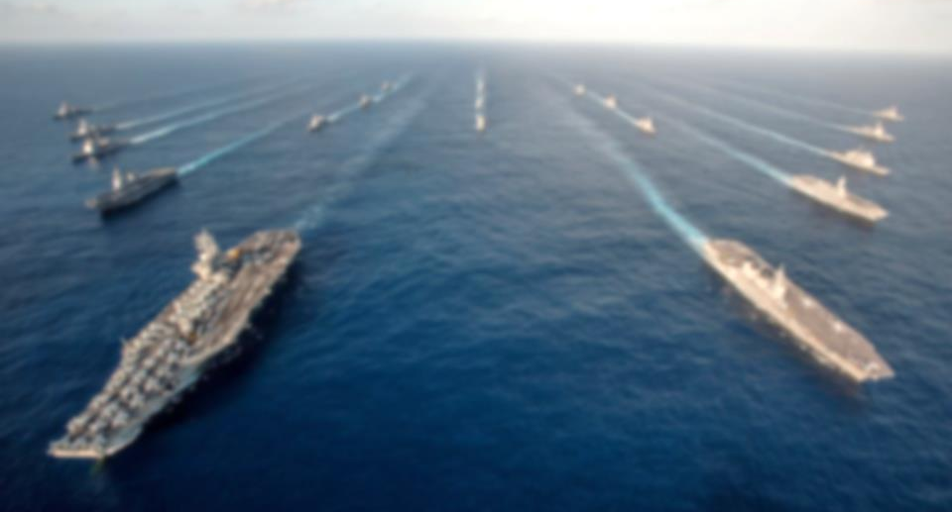
MISSION & STRATEGIC IMPORTANCE
STRATEGIC FACILITIES
STRATEGIC WATERFRONT
UNIQUE FEATURES
Notes:
NBK is perhaps the Navy’s most complex base in the world.
I think we have everything except a runway and a golf course. I’d even argue that Nimitz and Stennis would say we do have runways, but those Air Force guys down at Joint Base Lewis-McChord might have something to say about that.
NBK has the most unique capabilities of any base in the world.
* PSNS has the only West Coast drydock capabilities for NIMITZ-Class carriers (who are scheduled to remain for decades)
* We’re wiring and making preparations to hold the newest carrier, the FORD class.
* Only drydocks capable of holding the eight Ohio/Trident submarines both at Bremerton and Bangor.
* One of two Strategic Weapons Facilities at Bangor (the other is on the East Coast - King's Bay Georgia, just north of Jacksonville, Florida).
* Manchester is largest Navy fuel depot in the continental U.S. at 79 million Gallons - provides fuel for the ships here in in the PNW and the aircraft at Naval Air Station Whidbey Island in Oak Harbor, Washington.
* Keyport is the only West Coast heavyweight torpedo manufacturer that all of our submarine carry, and the only lightweight torpedo manufacturer that are carried on many other platforms.
*Keyport recently opened an Unmanned Undersea Vehicle facility that will take the Navy into the future in these systems.
By the way, I think it is pretty cool that we own the railway from Bangor-Bremerton, down WA Route 3, and all the way to Shelton (Washington). Can't wait to ride the train one of these days!
In short, we aren't going anywhere. You can't find the things we do here at any other place in the world. When making your long-term business plans, you need to make sure you include the Navy and its impact.

Slide 10
QUESTIONS?
?
Notes:
Well that’s all I have for the official presentation.
With that being said, I’d be happy to take about five (or 10) minutes to answer a few questions.
(after Q & A session, click)

Slide 11
CONTACT US
(360) 627-4030
www.cnic.navy.mil/kitsap/
Pao.nbk.cnrnw@navy.mil
Notes:
If you do have any more questions, or would like more information, please contact us or check out our public website. The contact information is our public affairs office.
(after giving every one time to record information, click)

Slide 12
YOU MADE IT!
THANK YOU!
Notes:
Every one made it without falling asleep or having any “emergency” phone calls.
(click)
Thank you for your time and attention today.

